Slide 1
SMARTFLOW: AI DRIVEN TRAFFIC MANAGEMENT SYSTEM
Guided By,
Mr. Jaison CS
Dept. of ECE
AJCE
Presented By,
Group 10
Amaljith T P, AJC21EC015
Binu Ajmal Shah, AJC21EC034
Denil C Varghese, AJC21EC038
Joel Jackson John, AJC21EC045

Slide 2
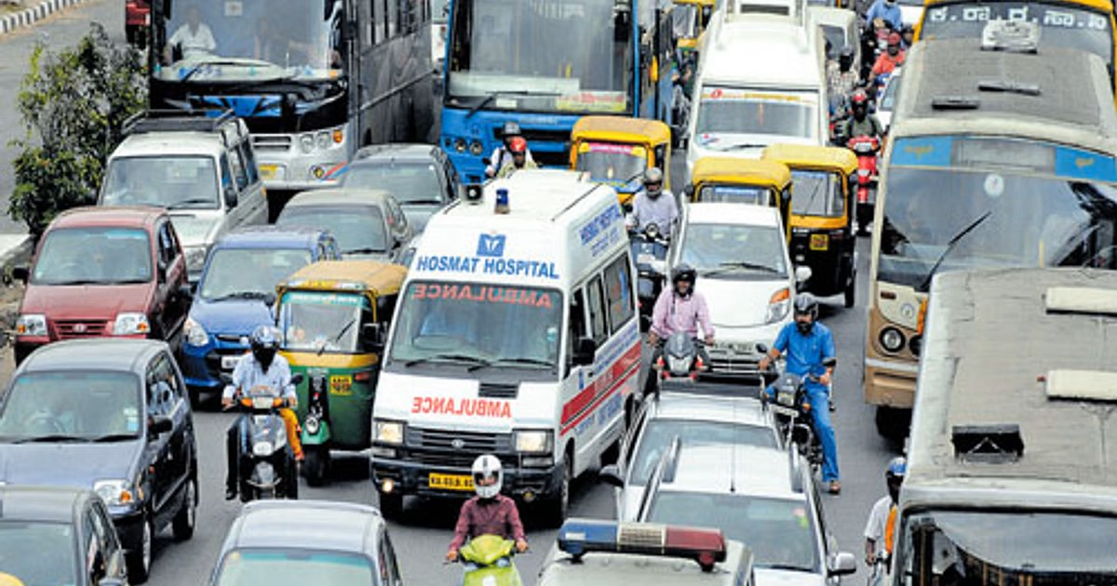
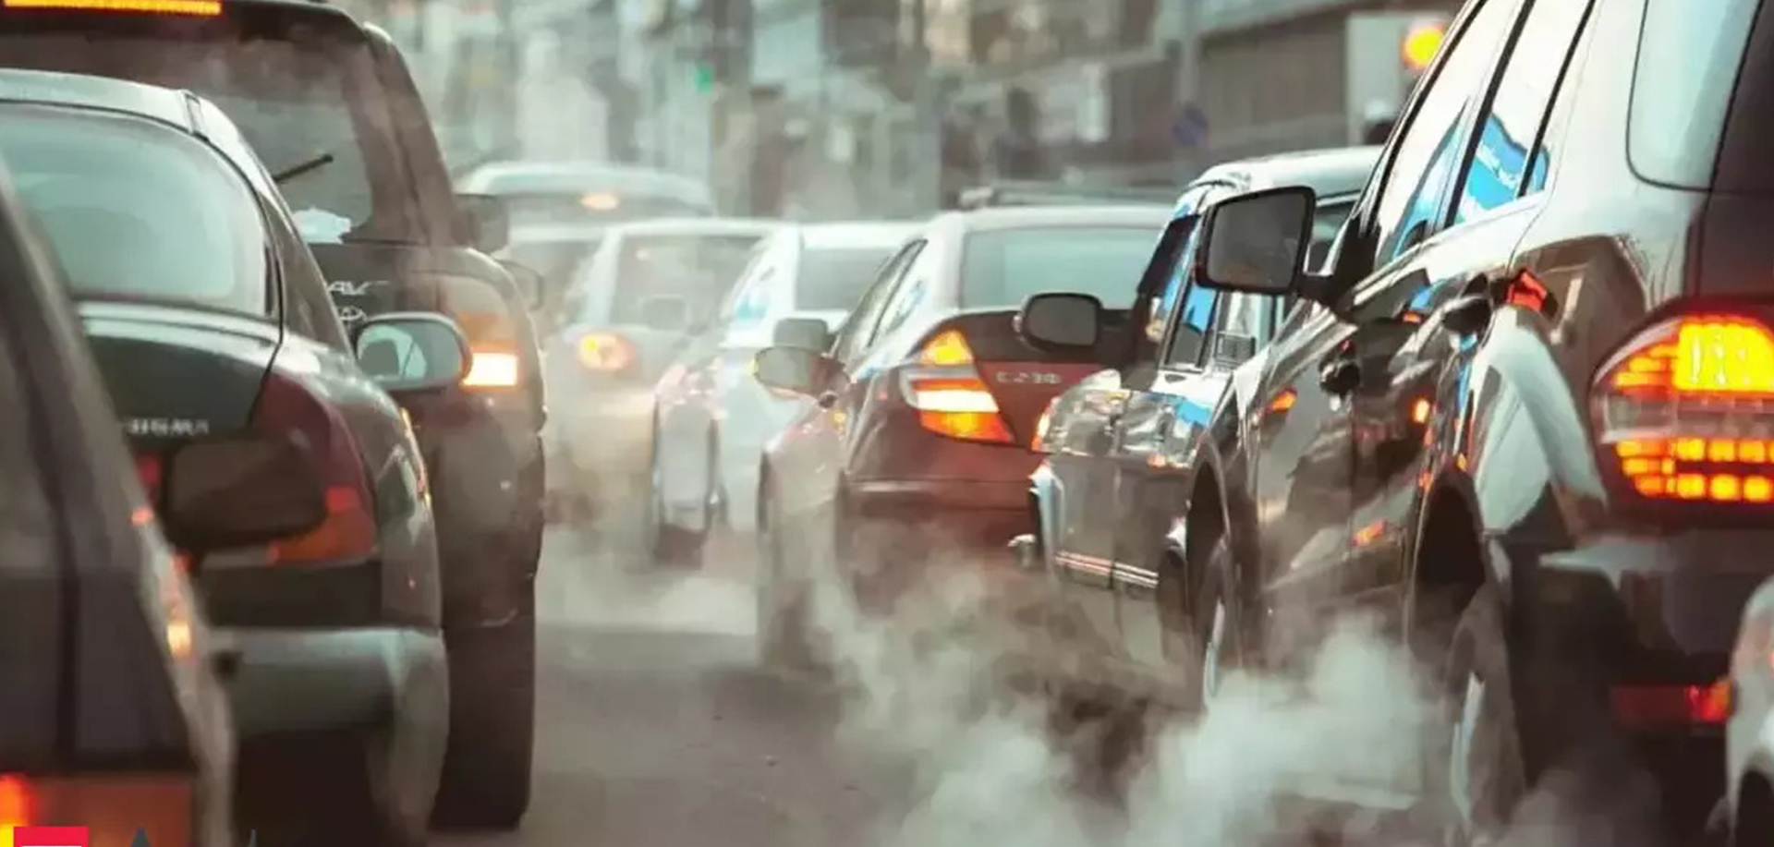
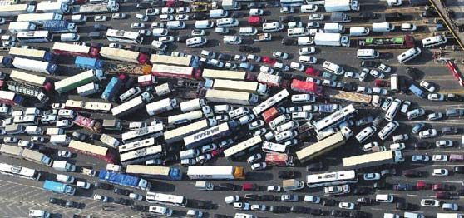
INTRODUCTION
Traffic congestion causes delays, fuel wastage, and pollution.
Emergency vehicles face difficulty navigating congested areas.
Traditional traffic control uses IR, UV, and RFID sensors.
Existing systems require costly infrastructure and have limited adaptability.

Slide 3
OBJECTIVE
Develop an AI-powered smart traffic management system.
Reduce traffic congestion using real-time vehicle density analysis.
Automate signal control based on live traffic conditions.
Ensure quick clearance for emergency vehicles.
Provide a user-friendly mobile application for real-time updates.
Enable admin monitoring via a web-based dashboard.

Slide 4
REVIEW OF LITERATURE
SL.NO | Authors | Title | Journal/Year of Publication | Method | Observations made
1 | W.A.C.J.K. Chandrasekara; R.M.K.T Rathnayaka; L.L.G Chathuranga | A Real-Time Density-Based Traffic Signal Control System | IEEE Sensors, 2020 | Data Collection, Data Processing & Analysis, System Feedback & Learning | Efficiency Improvement, Emergency Handling, Data-Driven Decision Making
2 | Uthara E. Prakash; K.T Vishnupriya; Athira Thankappan; Arun A. Balakrishnan | Density Based Traffic Control System Using Image Processing | ICETIETR, IEEE,2018 | Data Acquisition, Image Preprocessing, Real-Time Monitoring and Feedback | Dynamic Signal Control, Cost-Effective, Scalability
3 | Er. Faruk Bin Poyen, Amit Kumar Bhakta, B.Durga Manohar, Imran Ali, ArghyaSantra, AwanishPratap Rao | Density Based Traffic Control | International Journal of Advanced Engineering, Management and Science ,2015 | Data Collection, Traffic Density Estimation, Emergency Vehicle & VIP Detection | Integration of Advanced Technologies, Challenges and Limitations

Slide 5
REVIEW OF LITERATURE(cont:)
4 | K.Vidhya, A.Bazila Banu | Density Based Traffic Signal System | IJIRSET, ICIET 2014 | Adaptive Signal Timing Control, Analyze past traffic patterns | Use of YOLO, Ultrasonic, Infrared
5 | Mahendrakumar Subramaniam , Chunchu Rambabu, Gokul Chandrasekaran ,1and Neelam Sanjeev Kumar | A Traffic Density-Based Congestion Control Method for VANETs | Hindawi Wireless Communications and Mobile Computing (2022) | Prioritization for Emergency Vehicles, Blockchain for Security | Dynamically adjusts traffic, Edge Computing & 5G
6 | Nik Nur Shaaadah Nik Dzulkefli, Suziyani Rohafauzi, Afiza Nur Jaafar, Muhammad Shahmir Selamat, Nazrul Syafi Azman, and Muhammad Zakwan Zakaria Muhammad | Density Based Traffic System via IR Sensor | Journal of Physics(2019) | Data Collection Using IR Sensors, Adaptive Signal Control, Data logging | Cost-Effective Solution, Limitations in Detection Accuracy, Multi-Sensor Approach

Slide 6
REVIEW OF LITERATURE(cont:)
7 | Nassim Ammour,Haikel Alhichri,Yakoub Bazi,Bilel Benjdira,Naif Alajlan and Mansour Zuair | Deep Learning Approach for Car Detection in UAV Imagery | College of Computer and Information Sciences, King Saud University (2017) | UAV Image Acquisition, Object Detection Models, Hyperparameter Tuning | High Accuracy in Vehicle Detection, Computational Complexity
8 | Thuy Thi Nguyen; Helmut Grabner; Horst Bischof; Barbara Gruber | On-line Boosting for Car Detection from Aerial Images | IEEE Explore,2007 | Data Acquisition & Preprocessing, Feature Extraction Using Haar-like & HOG Features | Haar-like features, Occlusions and Shadows, Suitability for UAV-Based Car Detection

Slide 7
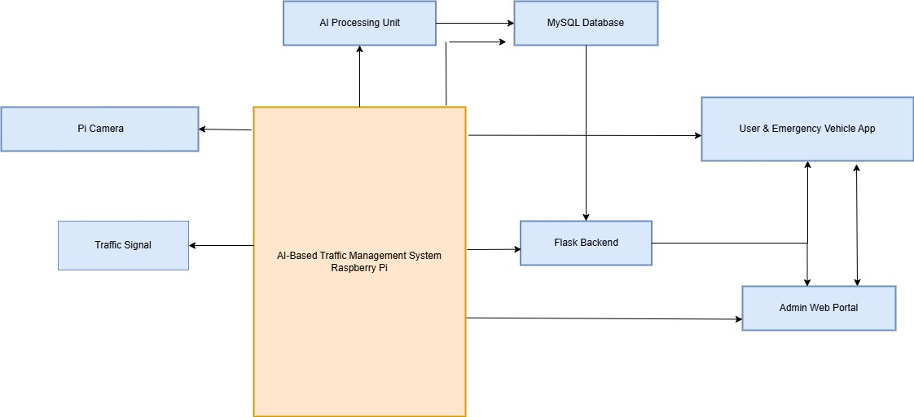
BLOCK DIAGRAM

Slide 8
Explanation of blocks
Pi Camera → Raspberry Pi: Captures live traffic images and sends them to the Raspberry Pi.
Raspberry Pi → AI Processing Unit: AI module analyzes vehicle density and determines signal timing.
AI Processing Unit → Traffic Signal: Adjusts green signal duration dynamically based on congestion data.
AI Processing Unit → MySQL Database: Stores real-time traffic data, emergency requests, and system logs.
Flask Backend ↔ MySQL Database: Handles data retrieval and updates between system components.

Slide 9
Explanation of blocks(cont:)
Flask Backend ↔ Mobile App: Sends live traffic updates, rerouting suggestions, and emergency clearance options.
Flask Backend ↔ Admin Web Portal: Enables monitoring of traffic conditions, emergency approvals, and manual signal overrides.
Admin Web Portal ↔ Mobile App: Admin can approve emergency vehicle registrations and receive feedback from users.

Slide 10
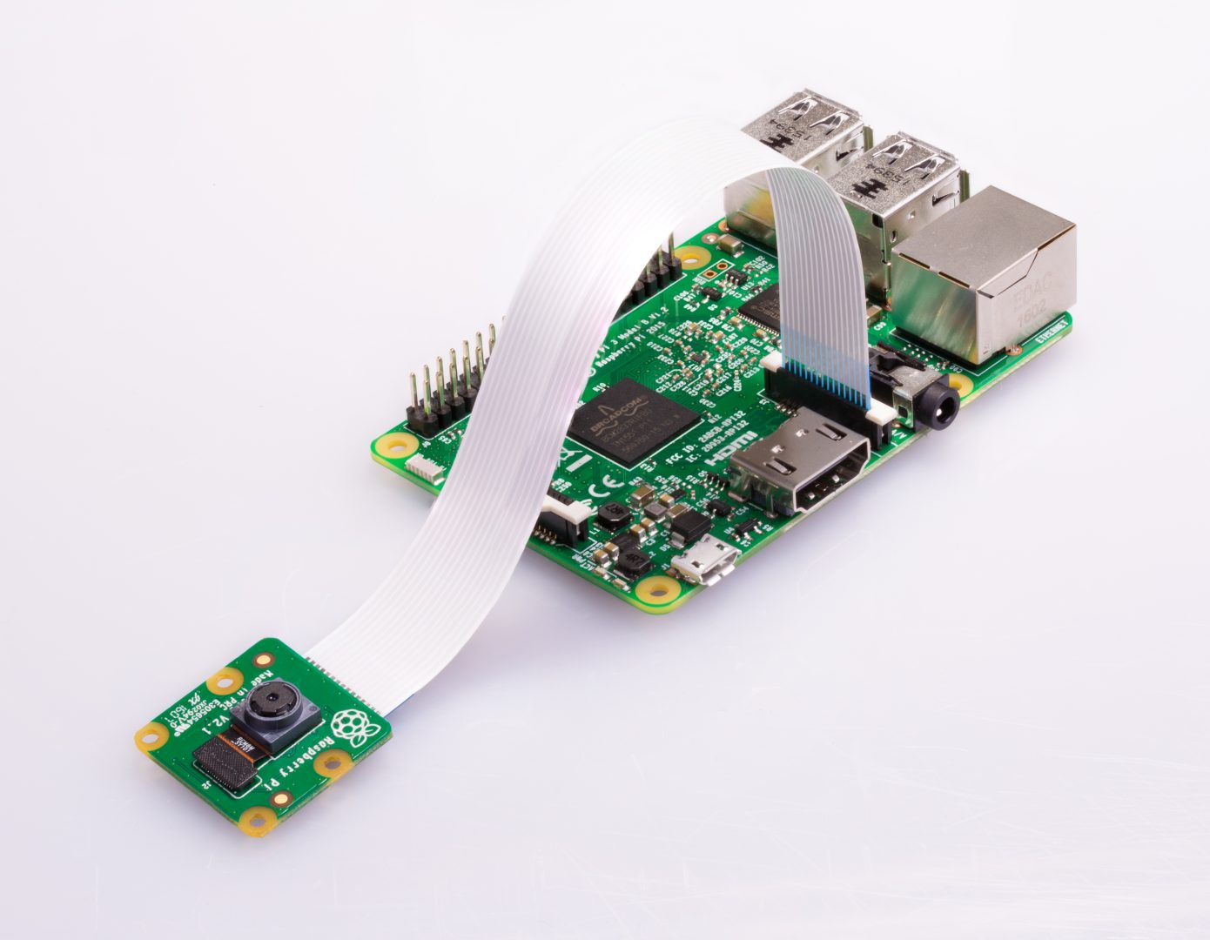
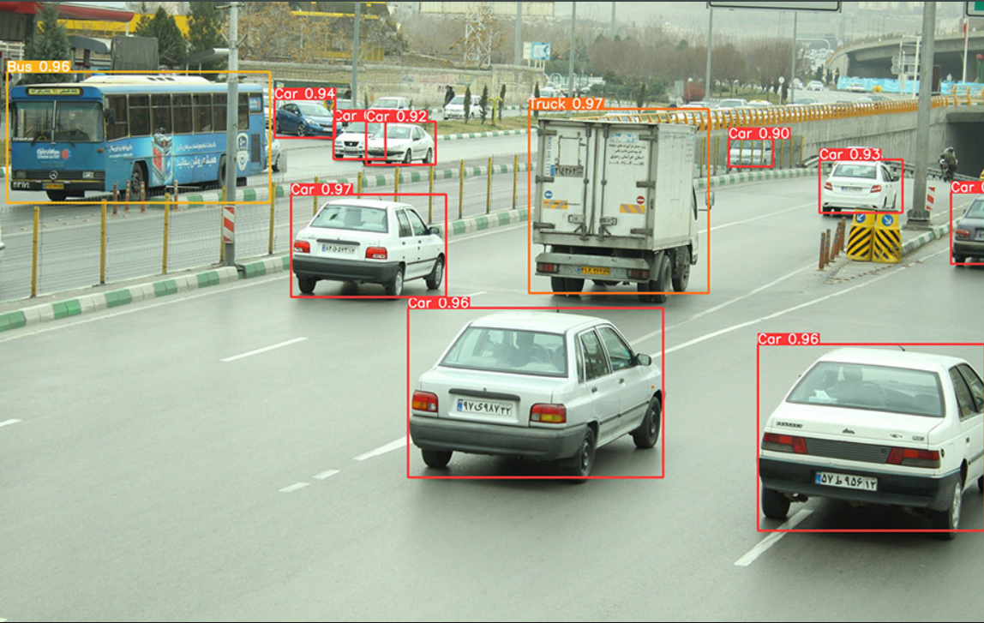
AI-Based Traffic Control System
Uses Raspberry Pi and Pi Camera to capture live traffic images.
AI Processing detects vehicle density at each junction.
Dynamically adjusts traffic signal timing based on congestion levels.
Reduces congestion, minimizes waiting time, and prioritizes emergency vehicles efficiently.
Fig. 1:(A) Raspberri Pi and Pi camera, (B)Vehicle detection using Yolo

Slide 11
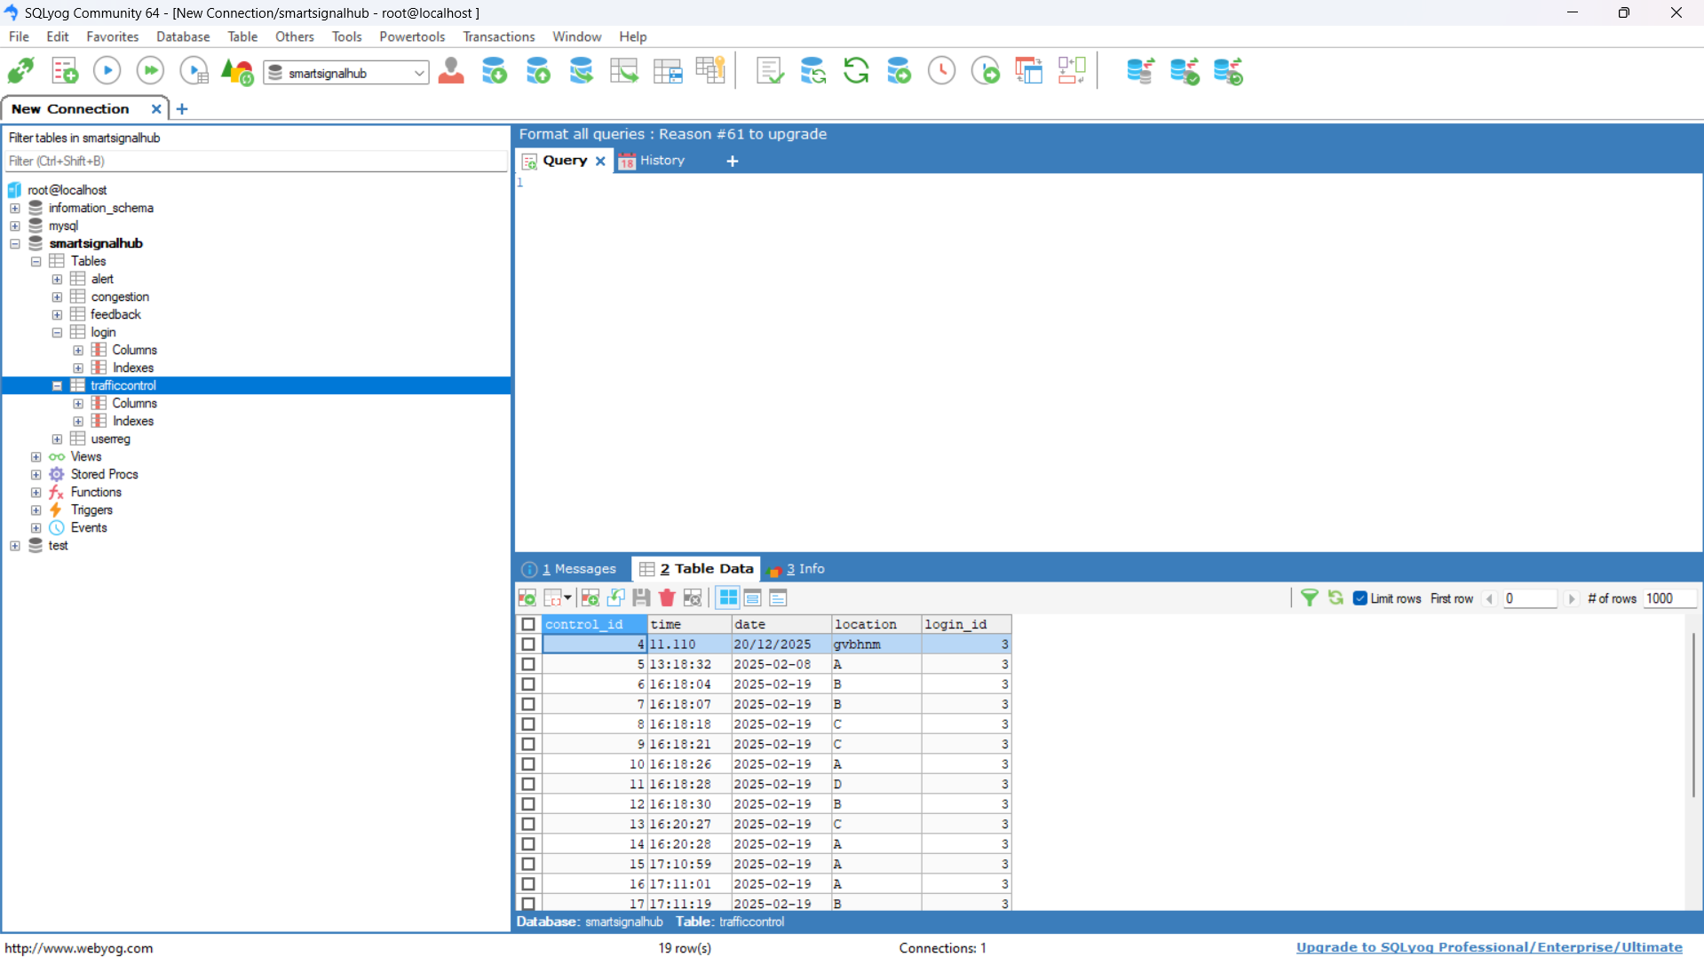
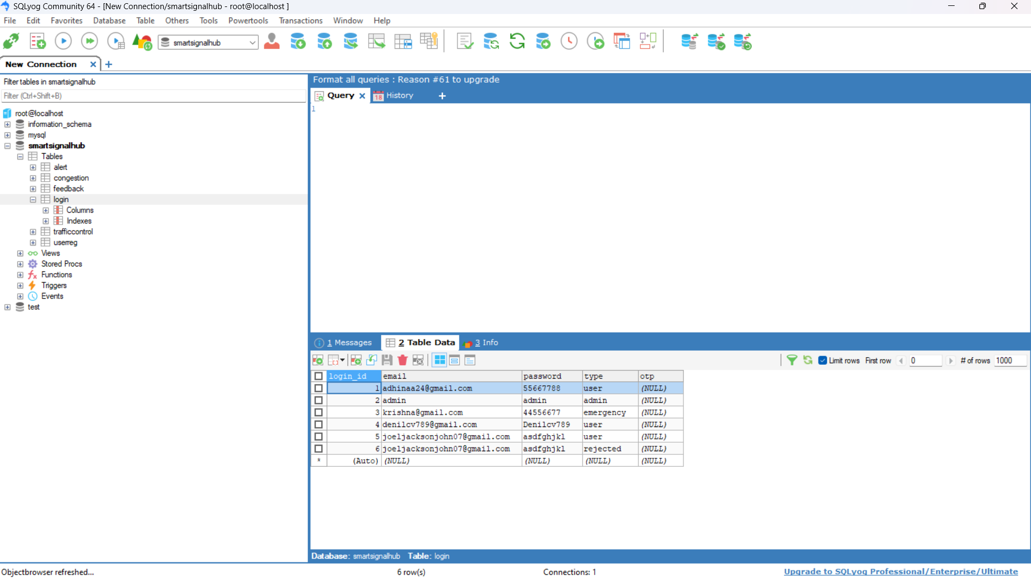
Database Management
Flask Backend facilitates communication between AI processing, mobile app, and web interface.
MySQL Database stores user details, emergency vehicle registrations, congestion levels, and system alerts.
Ensures data consistency for traffic control, rerouting suggestions, and emergency vehicle prioritization.
Fig. 2: (A) Real-time junction data stored in MySQL. (B)User information stored in MySQL

Slide 12
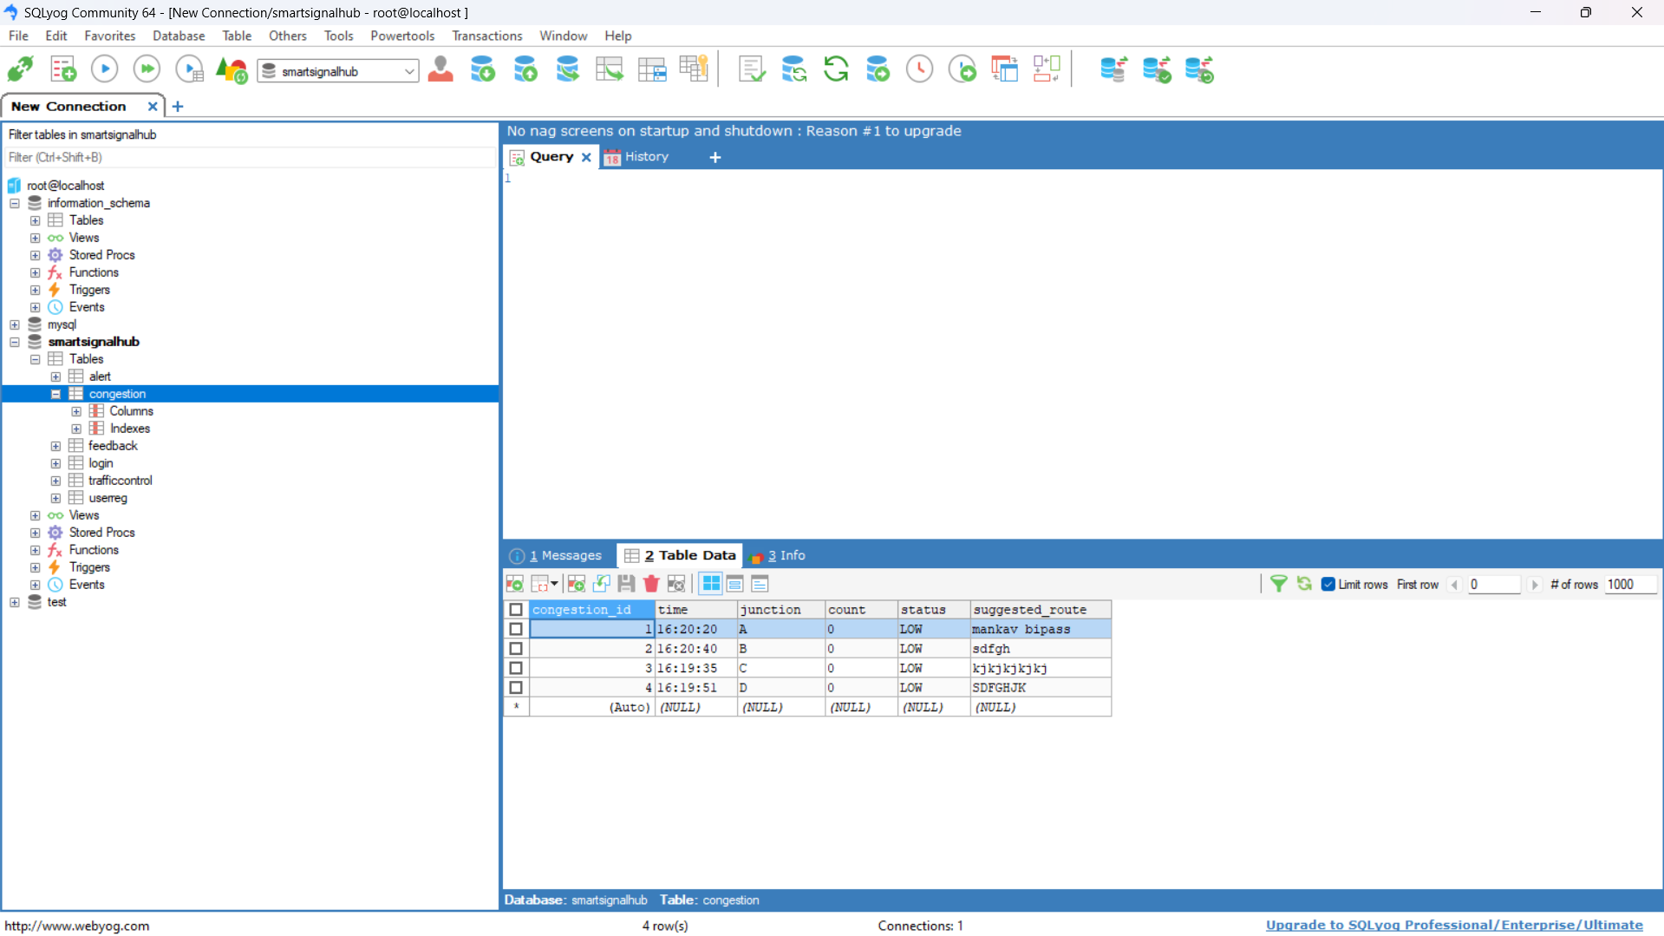
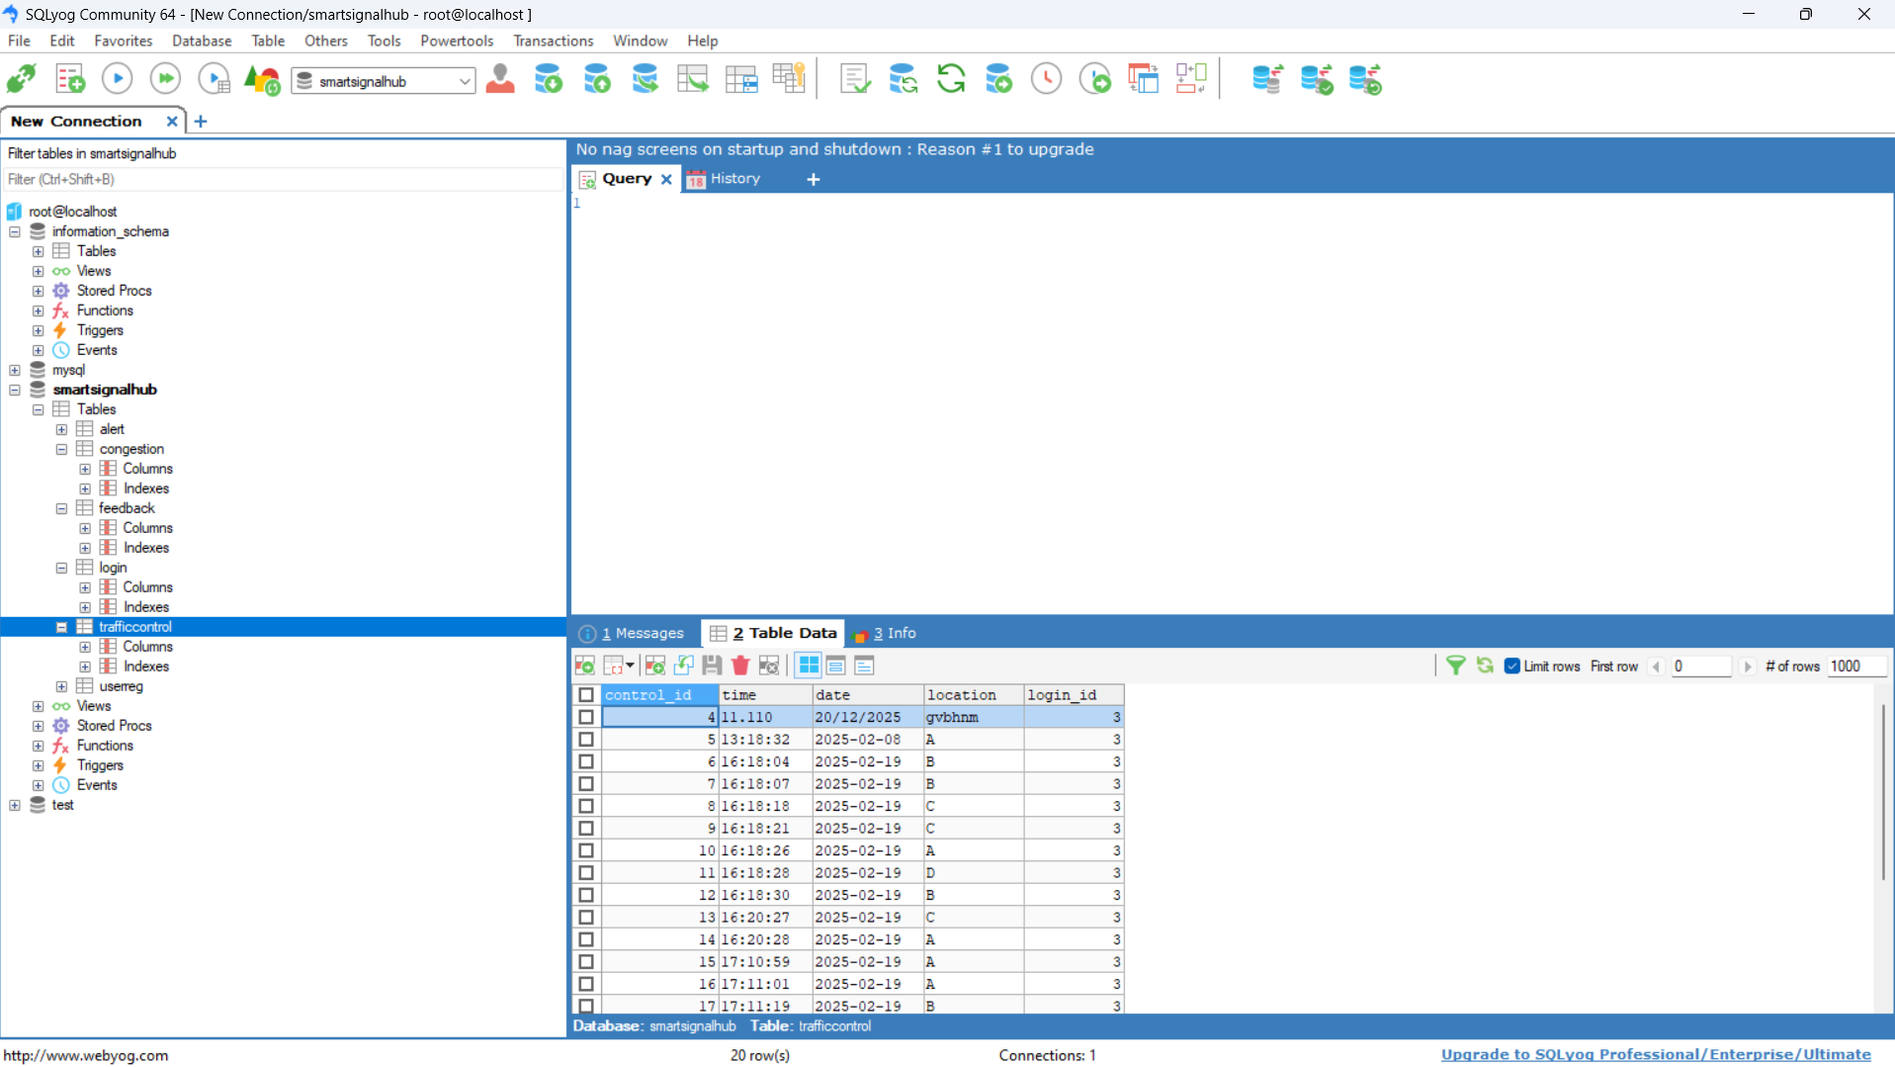
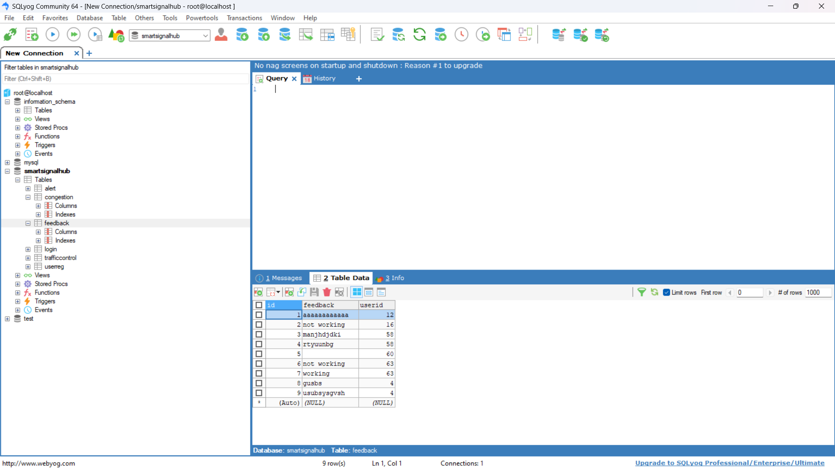
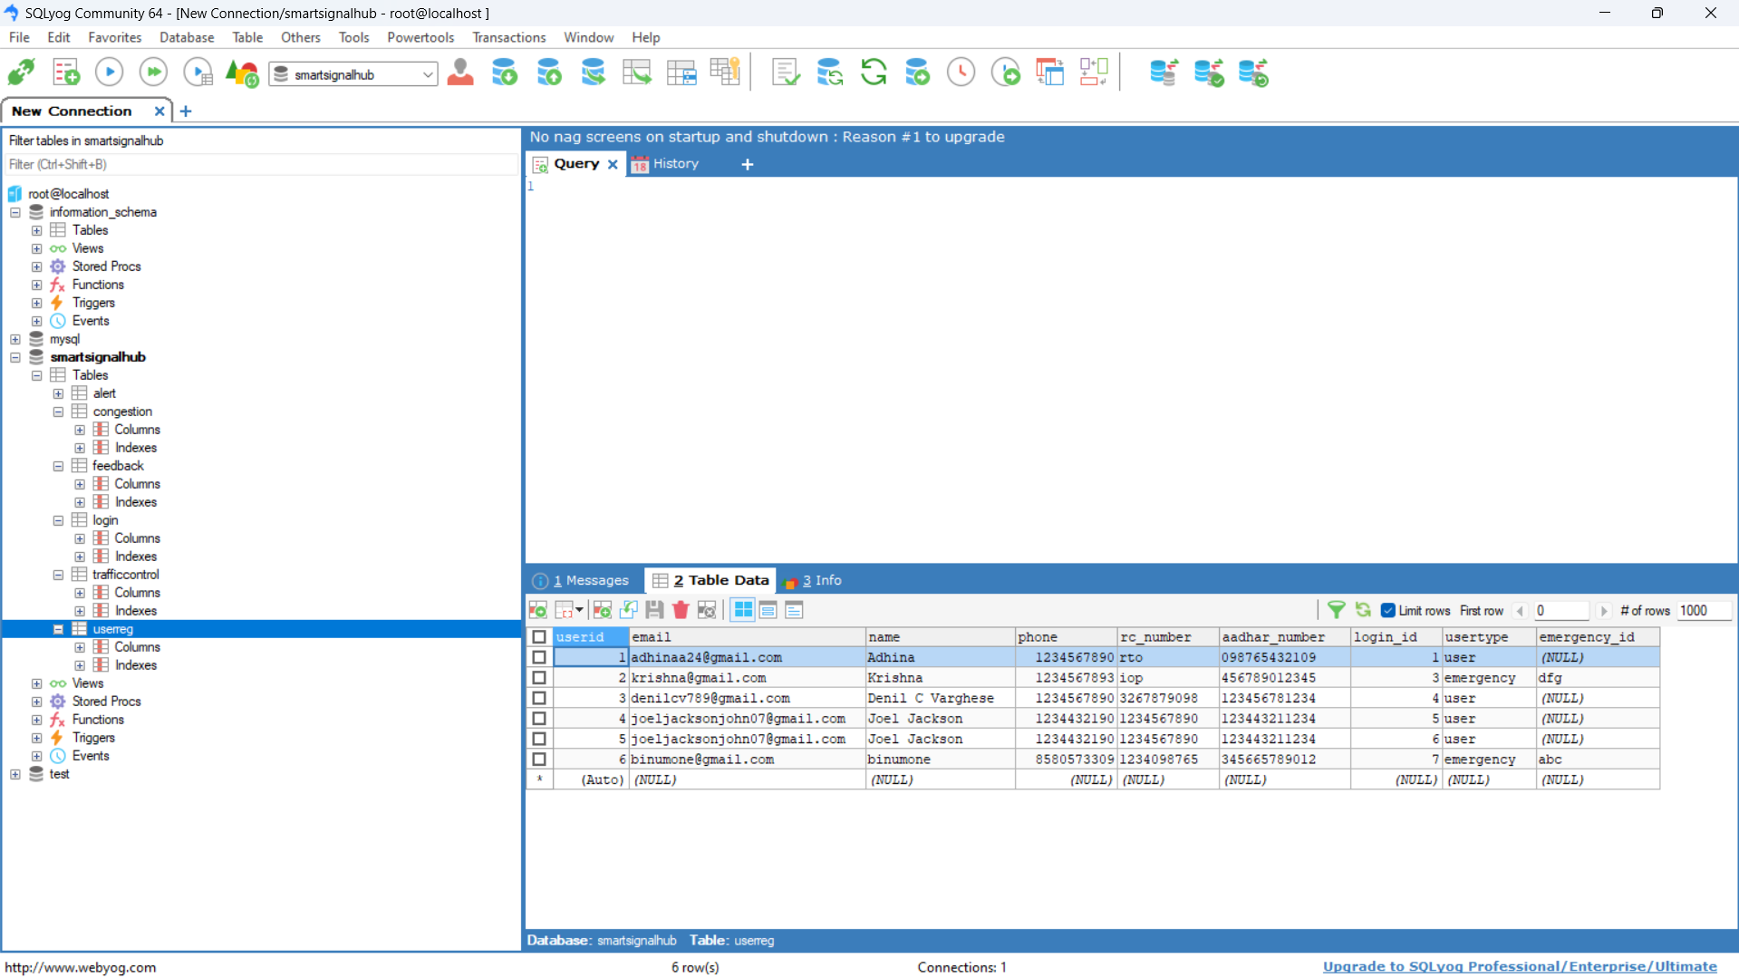
Fig. 3: (A) Database showing real-time traffic data of each junction, (B) Database shows current and previous traffic control informations, (C) Feedback sent by each user is stored here, (D) Every information about each user and emergency vehicle is stored

Slide 13
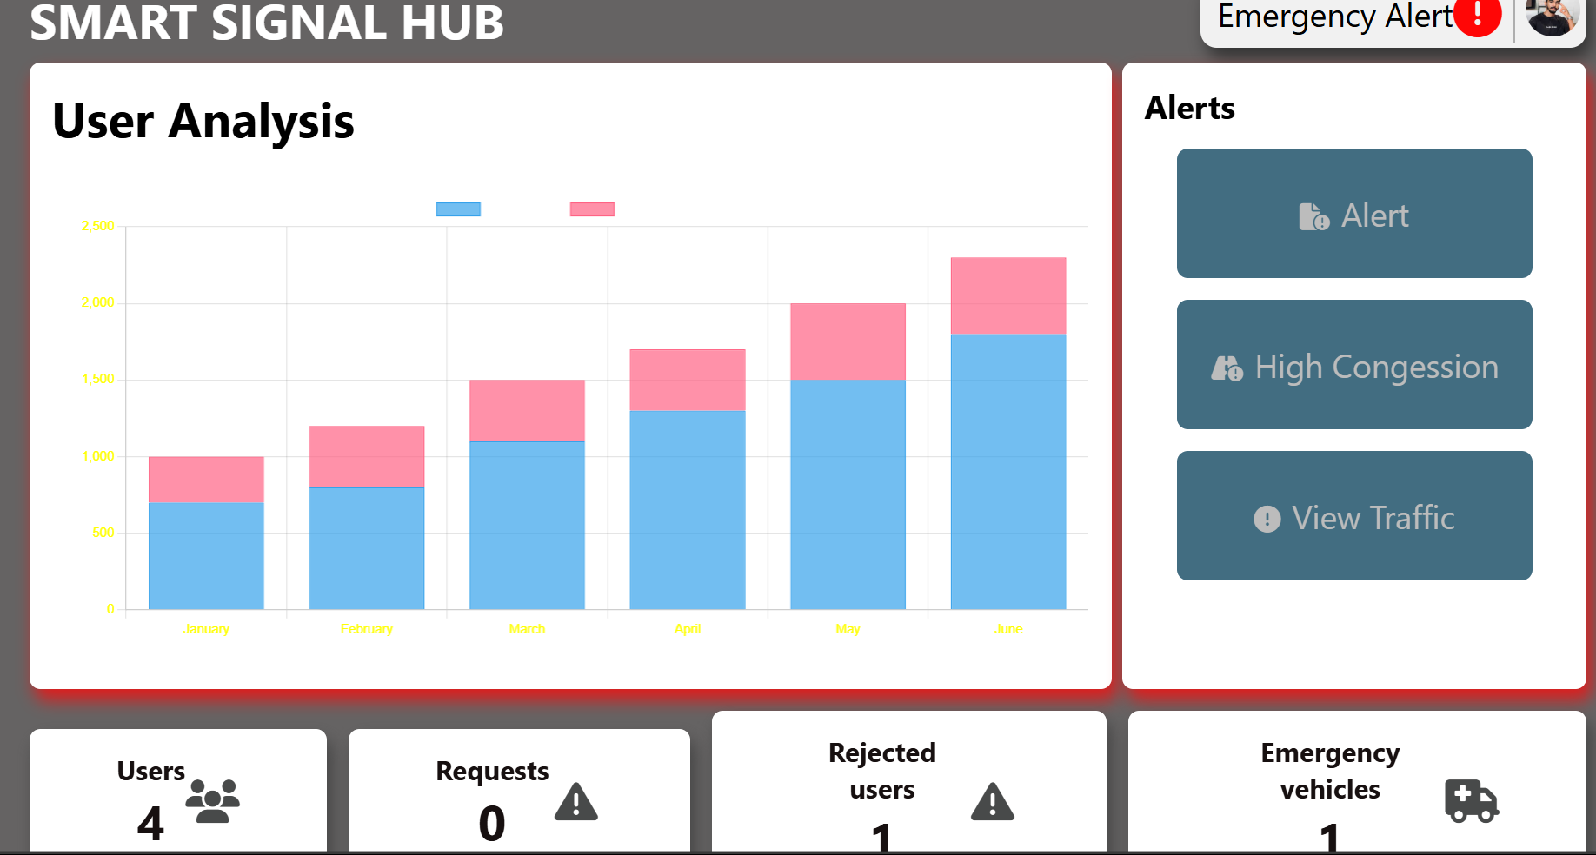
Admin Web Interface
Developed using Flask & HTML in PyCharm.
Live traffic monitoring via AI-processed data.
Emergency vehicle approval & registration management.
User feedback & system alerts handling.
Manual override for traffic signals if needed.
Fig. 3: Admin Website Interface

Slide 14
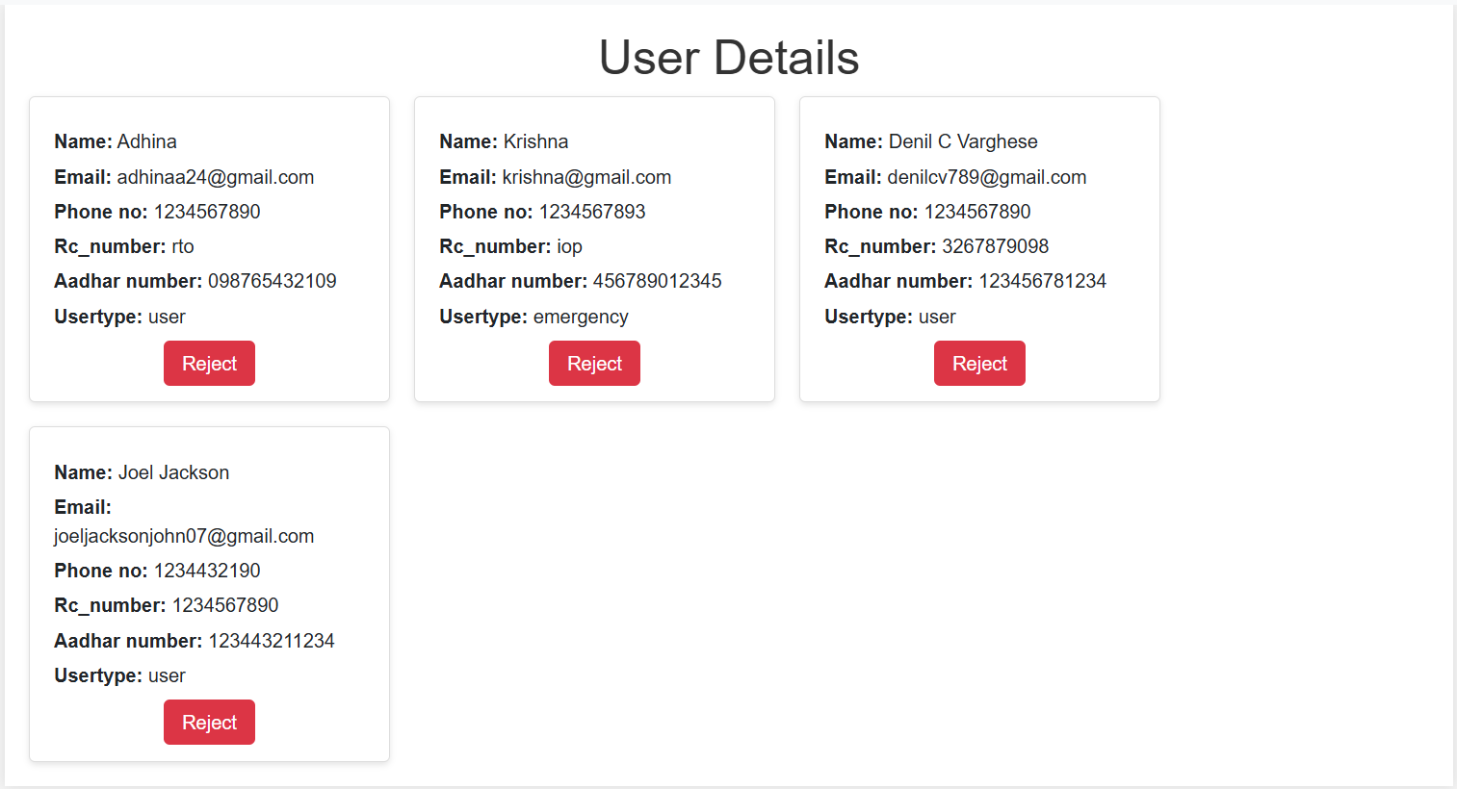
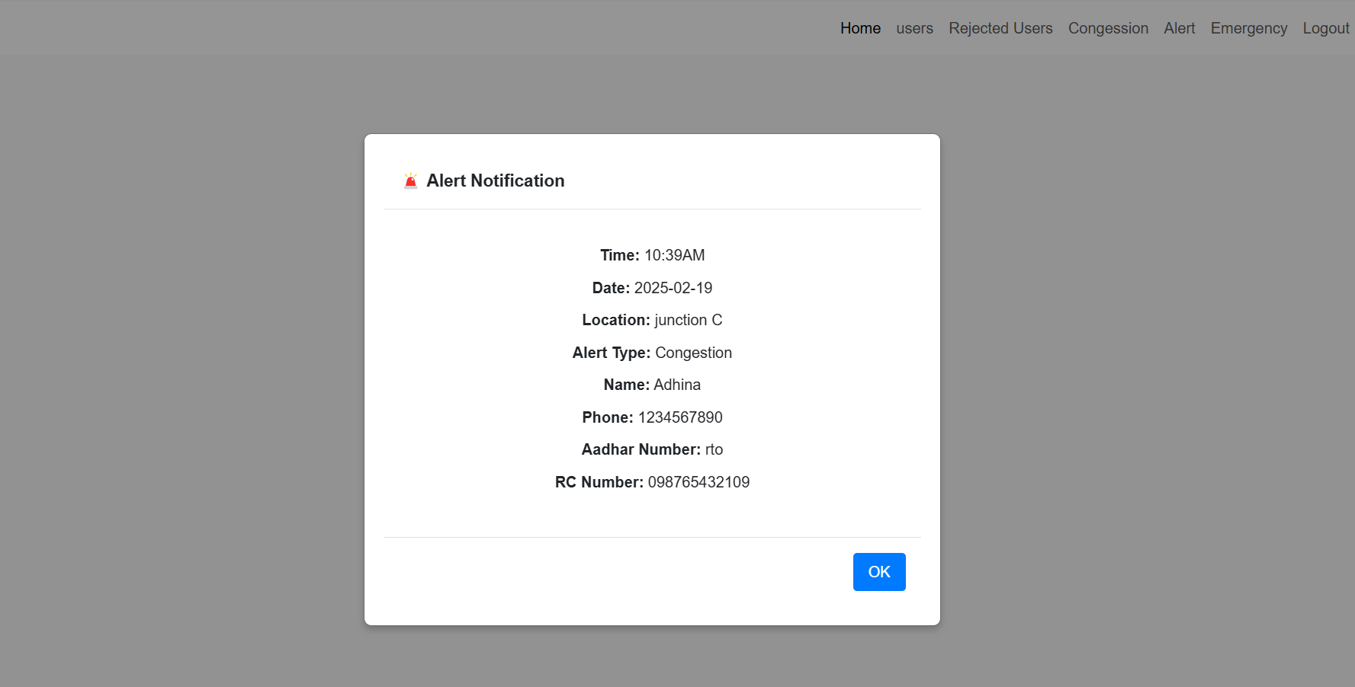
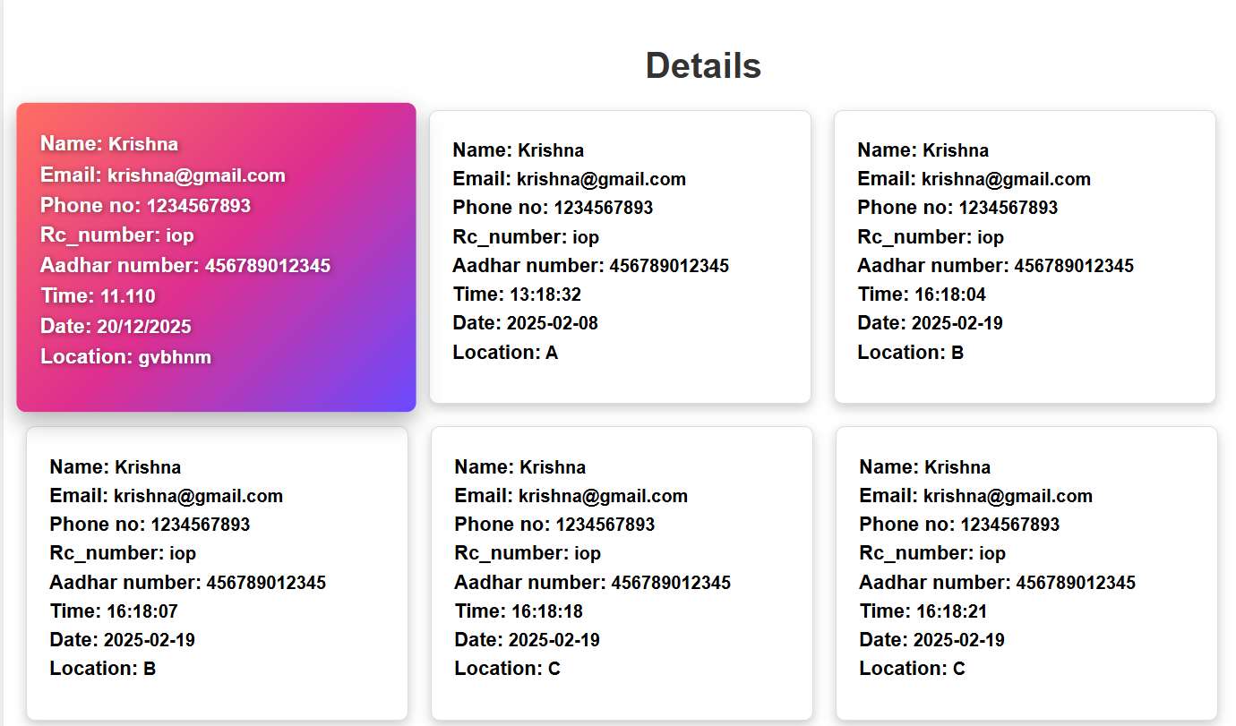
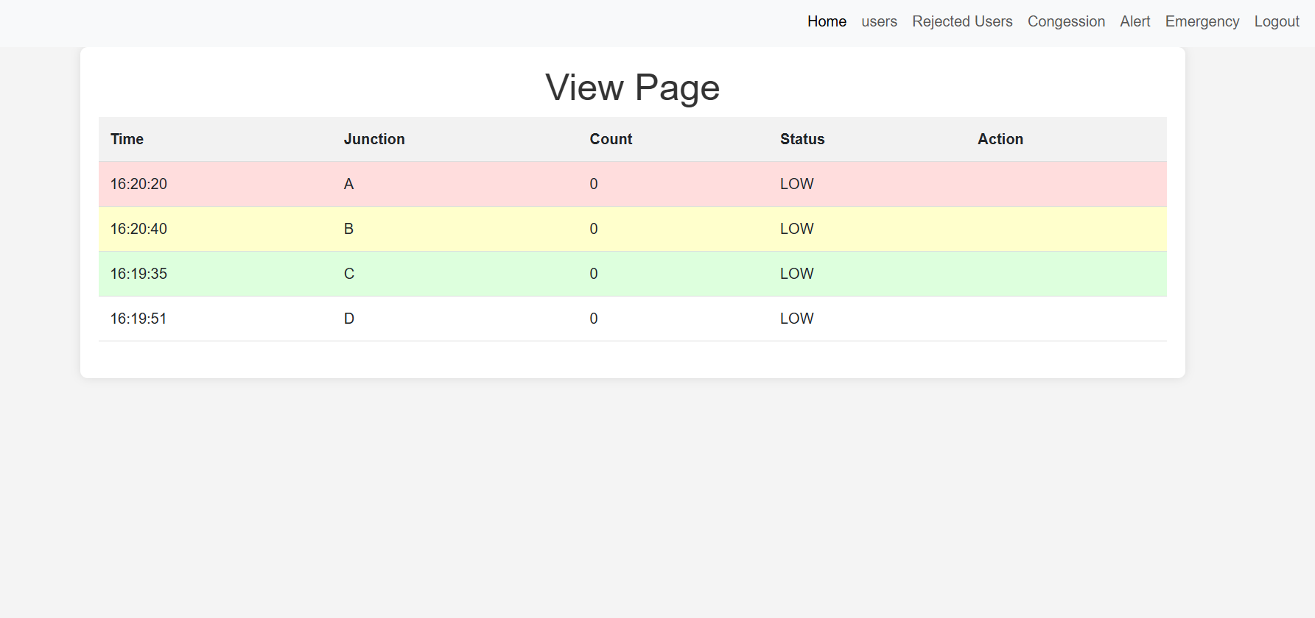
Fig. 4: (A) Website Interface showing various user details, (B) Website Interface showing previous alert notifications, (C) Real-time traffic congestion data with manual overriding and re-routing features, (D)Emergency vehicle details showing the emergency signal sent by them

Slide 15

User Mobile Application
Developed using Flutter in Visual Studio Code
Flask backend enables real-time data exchange between the app, database, and AI module.
Two separate logins:
User Features
Live traffic monitoring and congestion updates.
Rerouting suggestions for smoother travel.
Feedback submission to report traffic issues.
Emergency Vehicle Features
Priority lane clearance request for uninterrupted passage.
Ability to signal the system to turn specific lanes green.

Slide 16
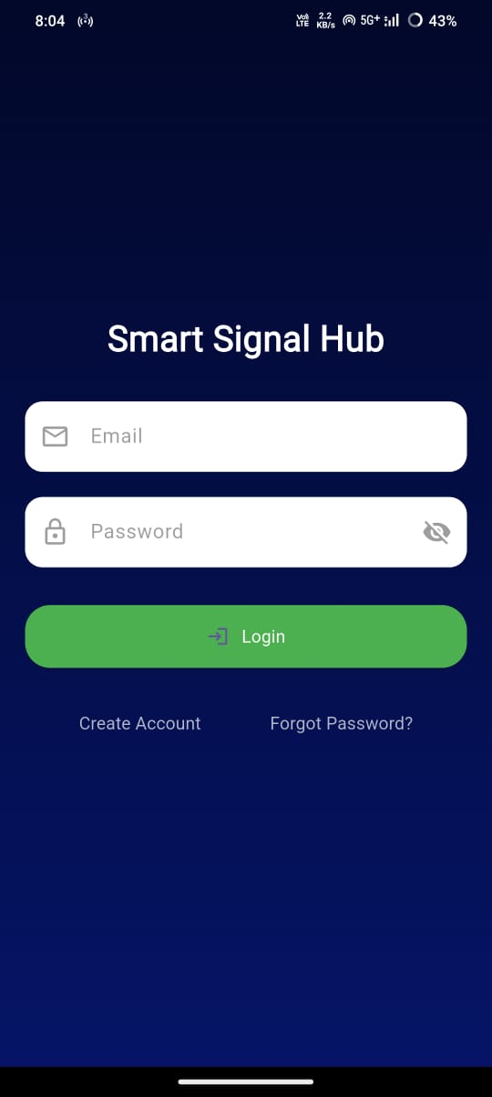
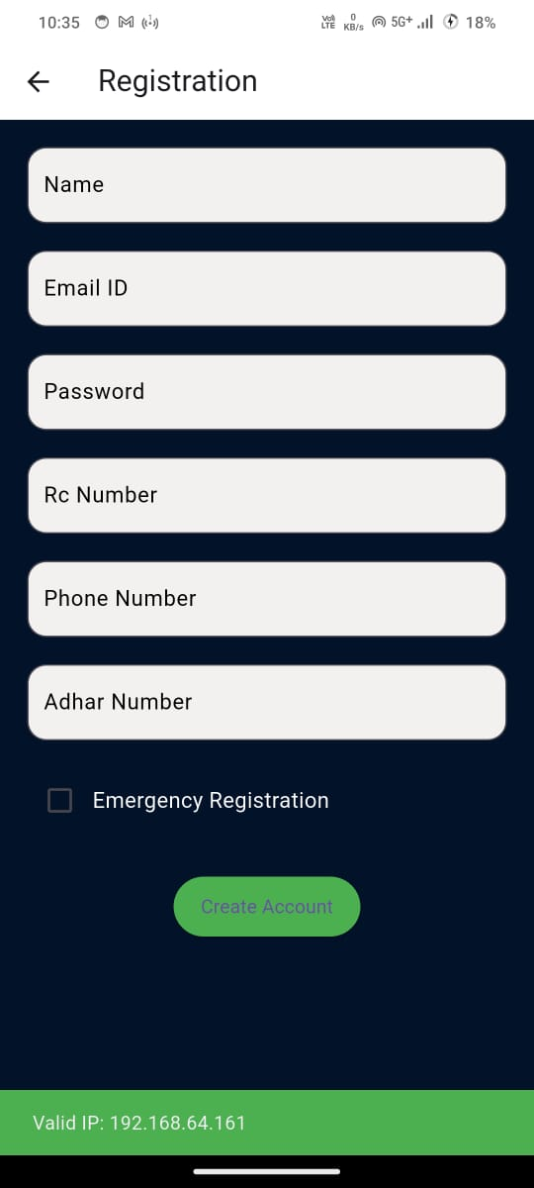
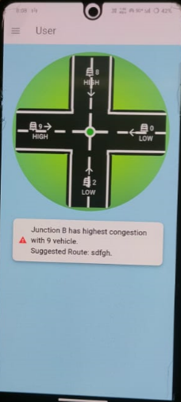
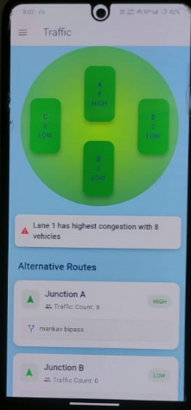
Fig. 4: (A) Mobile application User and Emergency vehicle interface, (B) Login page for user login, (C) User app interface providing live traffic details, rerouting suggestions and congestion details, (D) Emergency vehicle interface allowing vehicles to manually notify the traffic signal to reduce traffic congestion.

Slide 17
System Workflow
Step 1: Pi Camera captures real-time traffic images at junctions.
Step 2: Raspberry Pi processes images using YOLO for vehicle detection.
Step 3: AI calculates vehicle density and determines optimal green light duration.
Step 4: Traffic signal timing is dynamically adjusted based on congestion.
Step 5: Data is sent to the Flask backend for processing and storage in MySQL.
Step 6: Admin web portal displays live traffic data and allows manual control.
Step 7: User mobile app retrieves real-time traffic updates and rerouting suggestions.
Step 8: Emergency vehicles can request priority passage through the app.
Step 9: Admin approves emergency vehicle requests, and signals adjust accordingly.
Step 10: User feedback is stored in the database for system improvements.

Slide 18
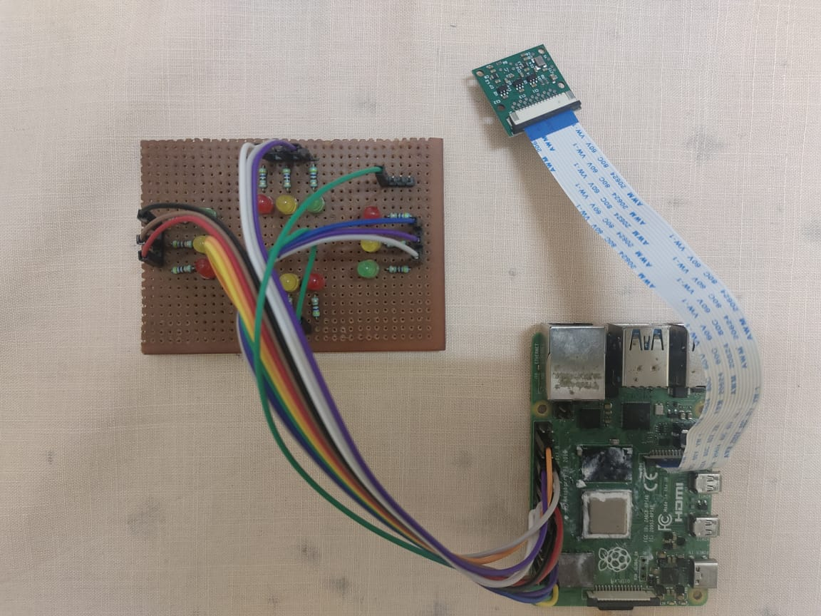
RESULT
Efficient Traffic Management – AI-based system reduces congestion dynamically.
Reduced Travel Time – Optimized signal timing decreases delays at junctions.
Emergency Vehicle Priority – Ensures faster clearance for ambulances and fire trucks.
Real-time Monitoring – Live data accessible through the admin web portal and mobile app.
Cost-effective Solution – Uses existing surveillance cameras, reducing infrastructure costs.
Scalability – System can be expanded to multiple junctions for city-wide implementation.
Fig. 5: Processing unit (Raspberry Pi), Pi Camera and traffic junction (Comprises of four lanes A,B,C & D)

Slide 19
FUTURE SCOPE
Integration with IoT and Smart City Infrastructure for enhanced automation.
Implementation of predictive analytics to forecast traffic congestion patterns.
Expansion to support V2X (Vehicle-to-Everything) communication for autonomous vehicles.
Incorporation of cloud-based traffic data storage for large-scale monitoring.
Collaboration with law enforcement for automated traffic rule enforcement.

Slide 20
CONCLUSION
AI-driven traffic management improves efficiency and reduces congestion.
Real-time monitoring and adaptive signal control enhance road safety.
Emergency vehicle prioritization ensures faster response times.
User-friendly mobile app provides live updates and rerouting suggestions.
Cost-effective solution utilizing existing infrastructure and AI technology.
Scalable and adaptable for future smart city applications.

Slide 21
REFERENCE PAPERS
W.A.C.J.K. Chandrasekara; R.M.K.T Rathnayaka; L.L.G Chathuranga “A Real-Time Density-Based Traffic Signal Control System” IEEE Sensors, 2020
Uthara E. Prakash; K.T Vishnupriya; Athira Thankappan; Arun A. Balakrishnan “Density Based Traffic Control System Using Image Processing” ICETIETR, IEEE,2018
Er. Faruk Bin Poyen, Amit Kumar Bhakta, B.Durga Manohar, Imran Ali, ArghyaSantra, AwanishPratap Rao” Density Based Traffic Control System Using Image Processing” International Journal of Advanced Engineering, Management and Science ,2015
K.Vidhya, A.Bazila Banu “Density Based Traffic Signal System” IJIRSET, ICIET 2014

Slide 22
REFERENCE PAPERS(cont:)
Mahendrakumar Subramaniam , Chunchu Rambabu, Gokul Chandrasekaran ,1and Neelam Sanjeev Kumar “A Traffic Density-Based Congestion Control Method for VANETs” Hindawi Wireless Communications and Mobile Computing(2022)
Nik Nur Shaaadah Nik Dzulkefli, Suziyani Rohafauzi, Afiza Nur Jaafar, Muhammad Shahmir Selamat, Nazrul Syafi Azman, and Muhammad Zakwan Zakaria Muhammad “Density Based Traffic Control System Using Image Processing” Journal of Physics(2019)
Nassim Ammour,Haikel Alhichri,Yakoub Bazi,Bilel Benjdira,Naif Alajlan and Mansour Zuair “Deep Learning Approach for Car Detection in UAV Imagery” College of Computer and Information Sciences, King Saud University(2017)
Thuy Thi Nguyen; Helmut Grabner; Horst Bischof; Barbara Gruber “On-line Boosting for Car Detection from Aerial Images” IEEE Explore,2007

